Slide 1
Object detector sensor
Cîmpanu Anastasia &
Sălăjan Denisa Patricia

Slide 2
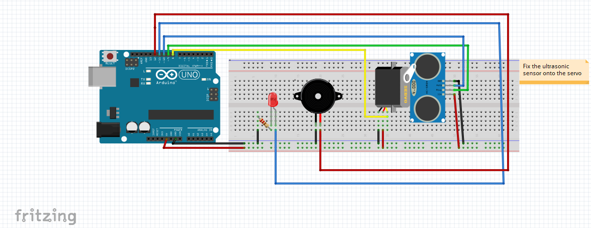

Slide 3
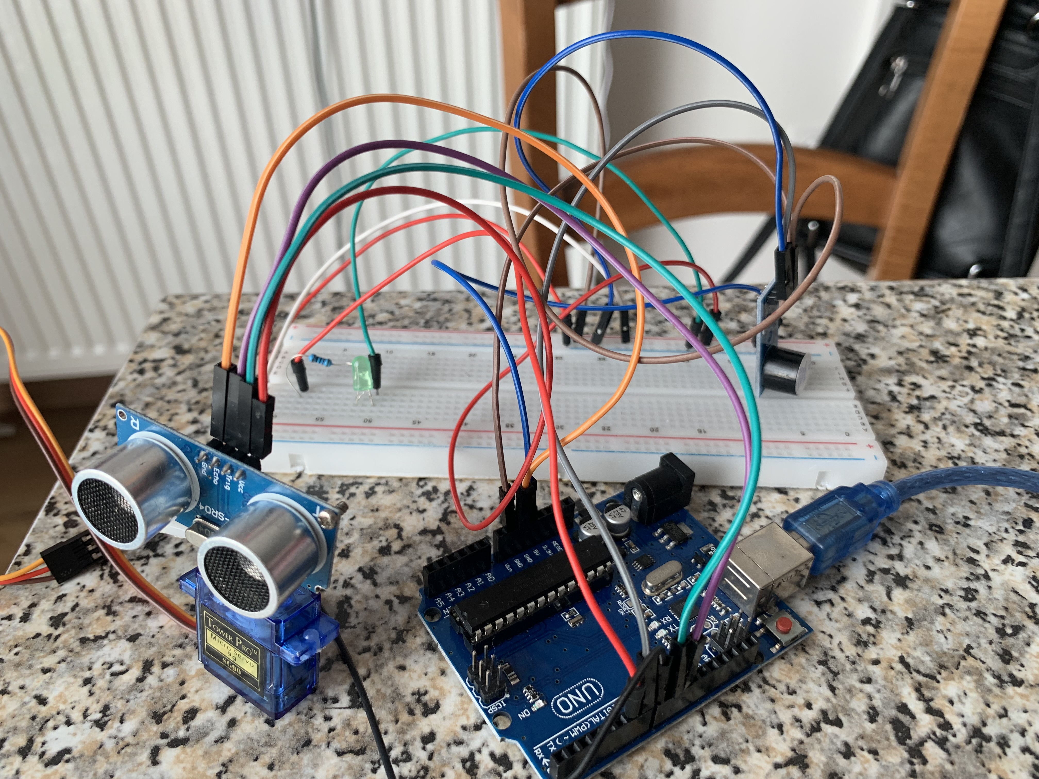

Slide 4
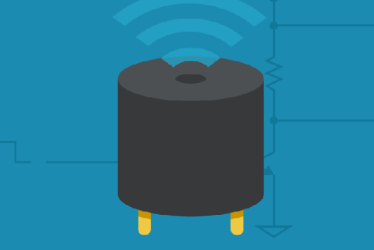

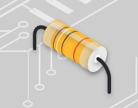
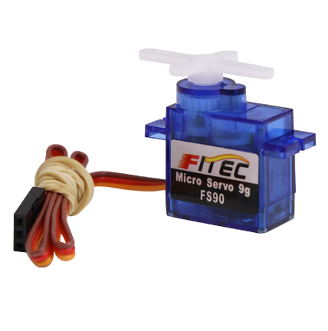
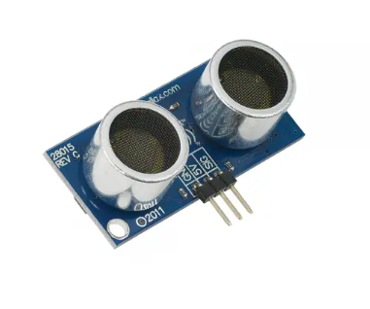
The components we used:
01
02
03
04
Buzzer
A led and a resistor
A servo motor
A sensor for the distance

Slide 5
How does it work?

Slide 6
A sensor that emits ultrasounds is attached to a servo motor, which rotates up to 180 degrees and back. If the ultrasound hits an object located within 20 cm, an echo is sent back to the sensor, and the buzzer turns on, indicating that something is in the way. Otherwise, the buzzer remains silent, and a green LED lights up to show that the path is clear.

Slide 7
Thank you !

